Slide 1

CELLANTRATECH
VivoDrive™
Targeted mRNA
delivery system
Developing nonviral RNA delivery
for in vivo T-cell programming
Thomas Wong, Technology Director
September 2026

Slide 2
CellantraTech investment overview
VivoDrive delivery technology with STEAP1 VivoCAR™ as the lead application
Program | Development status | Next value milestone
VivoDrive™ delivery | CD3 proof of concept Cell lines and human T cells | CD8 therapeutic format In vivo delivery validation
STEAP1 VivoCAR™ | R27 CAR function Engineered human T cells | Deliver R27 CAR mRNA Test in vivo tumor activity
Future applications | Research opportunity Partner-selected mRNA | Payload feasibility studies Subject to validation
Preclinical stage
Funding priorities
Proposed 12-month development program
Early research stage. CD3 delivery and R27 CAR-function results are separate evidence packages.
CellantraTech
02

Slide 3
The delivery challenge
VivoDrive combines T-cell targeting with an ApoE-binding module
Development requirement | VivoDrive approach
Reach target T cells | T-cell-binding VHH on the delivery system CD3 proof of concept, CD8 format complete
Limit liver delivery | Anti-ApoE module designed to reduce hepatic uptake Cell-model evidence and preliminary liver imaging
Support different payloads | Established LNP components with replaceable mRNA STEAP1 CAR mRNA is the lead planned payload
Development goal: functional mRNA delivery to T cells with lower liver exposure.
CellantraTech
03

Slide 4
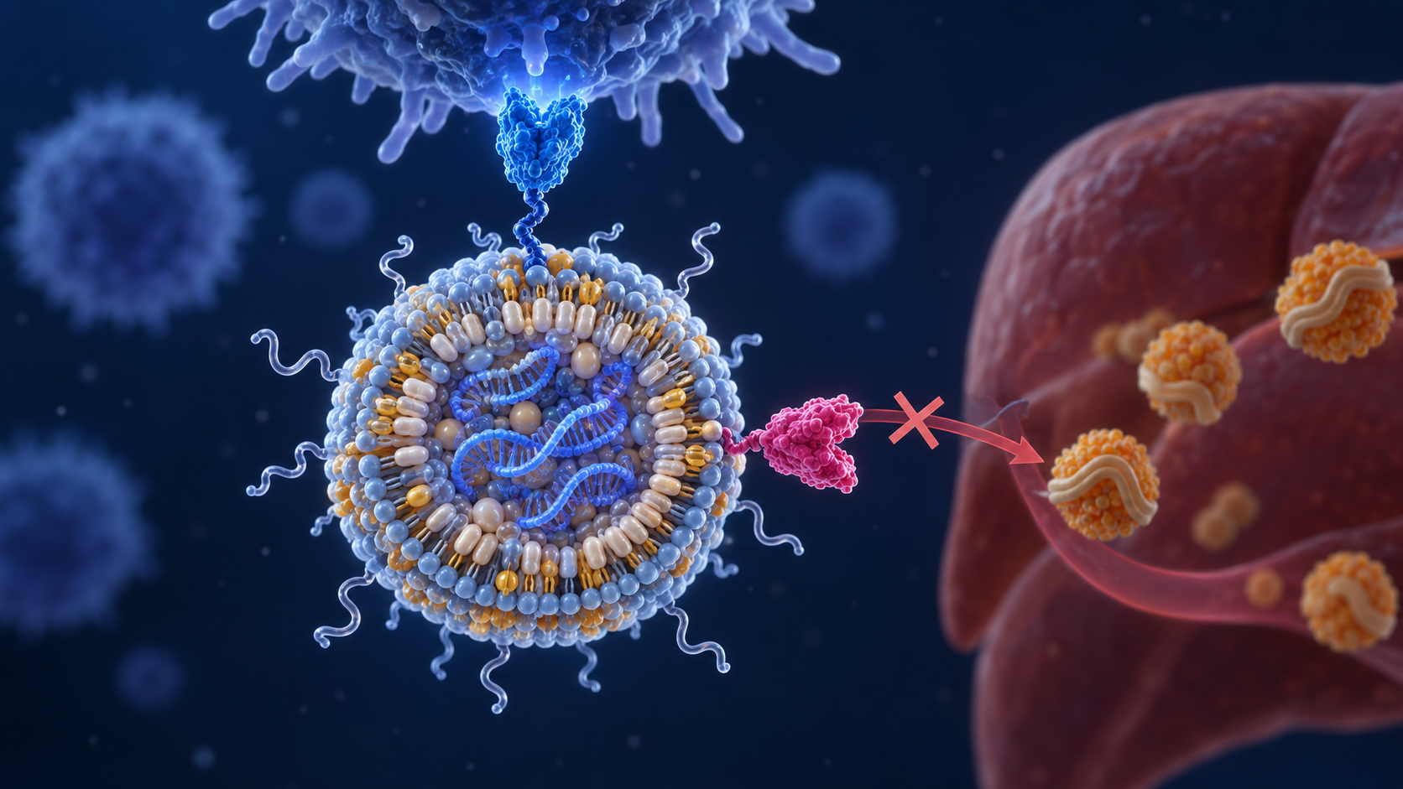
VivoDrive™: targeted mRNA delivery
Two antibody modules guide the lipid nanoparticle delivery system
T-cell targeting
Anti-CD3 VHH targets T cells.
Initial proof-of-concept format.
Liver de-targeting design
Anti-ApoE VHH binds surface ApoE.
Designed to reduce liver delivery.
A modular LNP platform
Established LNP components
with replaceable mRNA cargo.
VHH: single-domain antibody. Initial studies use the CD3 / ApoE tandem. CD8 development is separate.
CellantraTech
04

Slide 5
Delivery proof of concept
CD3 format: reporter expression in T-cell and liver-cell models
9.7×
Higher reporter-positive
Jurkat fraction
95%
Lower reporter-positive
HepG2 fraction
Preliminary internal summaries. Fold change and relative reduction are descriptive calculations.
CellantraTech
05

Slide 6
mRNA expression in primary human T cells
CD3 proof of concept in unactivated human blood immune cells
CD4+ T cells
CD8+ T cells
52–59%
35–51%
mCherry-positive cells
mCherry-positive cells
Approximately 2% with LNP-only control
Control experiments support a tandem-dependent delivery effect.
Preliminary data. Ranges span assay conditions, not donors. n=3 replicate wells per condition.
CellantraTech
06

Slide 7
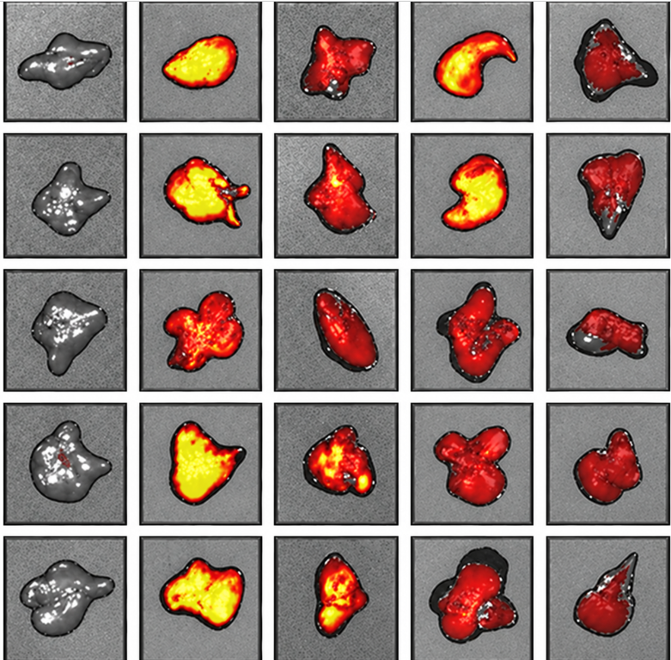
24-hour mouse liver imaging
Ex vivo liver EGFP imaging after mRNA-LNP administration
PBS
LNP
5 µg
Tandem
5 µg
LNP
2.5 µg
Tandem
2.5 µg
Liver expression assessment
Matched-dose comparison of
mCD3 tandem and LNP-only groups
at 2.5 µg and 5 µg.
Development objective:
reduce hepatic mRNA expression
Qualitative images. Per-animal quantification and common display-scale verified.
CellantraTech
07

Slide 8
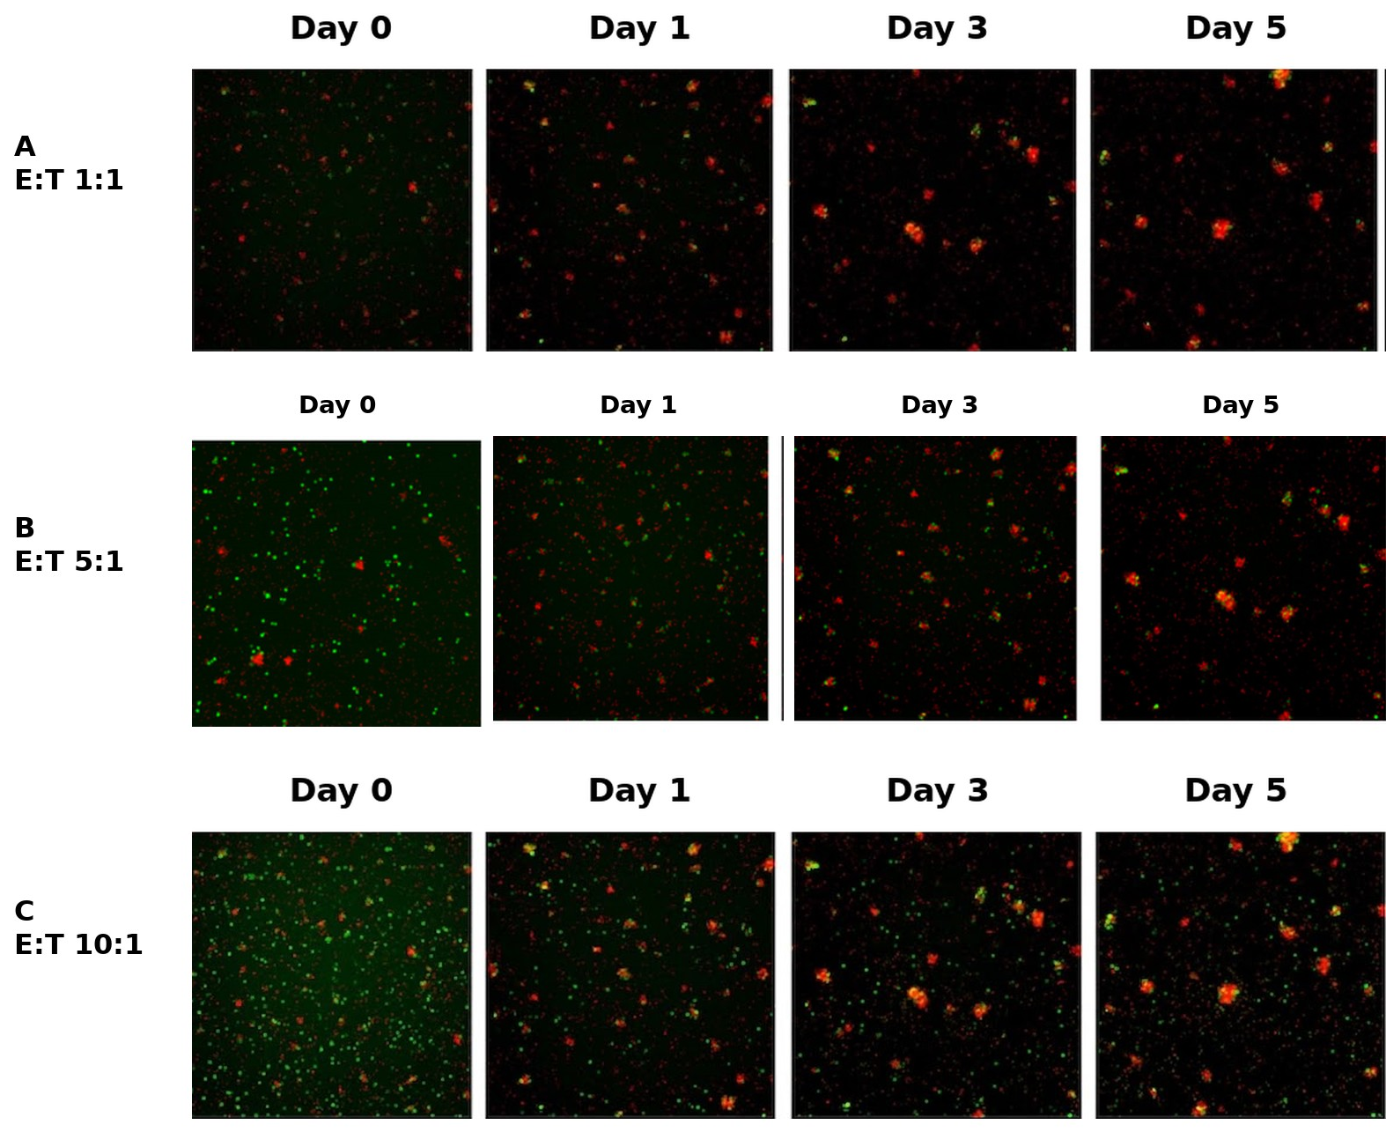
Lead program: STEAP1 VivoCAR™
R27 CAR function in engineered T cells for a prostate cancer program
70–85%
Marker-positive CD8 T cells (EGFRt)
Three cell-engineering experiments
5-day tumor-cell activity
Activity against 22Rv1 prostate cells
supported by three assay methods.
Next milestone: VivoDrive delivery of R27 CAR mRNA in vivo
Engineered-cell evidence. VivoDrive delivery of CAR mRNA and in vivo efficacy remain to be established.
CellantraTech
08

Slide 9
STEAP1 clinical precedent: Amgen
Phase 1 xaluritamig (STEAP1 × CD3) in metastatic castration-resistant prostate cancer
49%
24%
41%
PSA decline ≥50%
Objective response
Objective response
43 of 87 evaluable patients
All dose cohorts
16 of 67 evaluable patients
All dose cohorts
15 of 37 evaluable patients
Target dose ≥0.75 mg
Clinical evidence for STEAP1-directed T-cell activity
External target rationale. These results do not predict R27 CAR efficacy or safety.
Confirmed responses. N=97 treated, cutoff 28 March 2023. Cytokine release syndrome: 72%, mainly grade 1–2.
Kelly et al., Cancer Discovery 2024.
CellantraTech
09

Slide 10
Development and partnering strategy
A delivery platform and a lead therapeutic program provide two routes to development
Development route | Proposed path
VivoDrive platform | Evaluate partner-selected mRNA in target T cells Progress successful studies toward co-development
STEAP1 VivoCAR™ | Build the combined delivery and CAR-function package Seek therapeutic development collaboration
Expansion discipline | Prioritize the lead program and delivery validation Advance additional payloads after feasibility evidence
Partnerships are prospective. The initial budget funds experimental validation.
CellantraTech
11

Slide 11
Milestones that advance the platform
Proposed 12-month program, beginning after financing
Timing | Evidence to establish
0–2 months | CD8-format expression in human T cells Reproducibility across donors and production lots
2–5 months | Target T-cell expression in vivo Quantified liver expression and tolerability
5–7 months | VivoDrive delivery of R27 CAR mRNA CAR expression and activity in tumor models
7–12 months | Candidate selection and scale-up feasibility Plan for subsequent safety and regulatory studies
Partnership opportunities
Platform evaluation and RNA co-development
in oncology and autoimmunity
Proposed timing depends on experimental outcomes and financing. Partnerships are prospective.
CellantraTech
12

Slide 12
Use of funds
Proposed 12-month program to advance delivery and therapeutic validation
Planned use | Purpose
Research team | Delivery and CAR expertise
Lab infrastructure | Experimental capacity
Equipment | Formulation and analytics
Reagents and assays | Functional validation
In vivo studies / CRO | Delivery and tumor models
IP, CMC, regulatory, G&A | Development support
Next phase
Delivery and therapeutic validation
Proposed 12-month program
Target outcomes
Reproducible CD8-format delivery
Initial in vivo R27 CAR-mRNA evidence
Thomas Wong, Technology Director
info@cellantratech.com
CellantraTech
13

Slide 13
CELLANTRATECH
VivoDrive™
Targeted mRNA delivery
for in vivo T-cell programming
Delivery platform
Lead therapeutic program
CD3 proof of concept in human T cells
CD8 therapeutic format in development
STEAP1 CAR mRNA for prostate cancer
Combined in vivo validation planned
Thomas Wong, Technology Director
info@cellantratech.com
14

